Slide 1




A 415 Art: Single Cycle Microprocessor
EEE 416 –Microprocessor and Embedded Systems Laboratory
July 2023 Level -4 Term- 1
Project Proposal Presentation
Submitted by – Group 7
B.M. Emroj Hossain Towfik
1906013
Himel Kundu Utsha
1906014
Mohammad Shadman Saquib
1906020
Chinmoy Biswas
1906029

Slide 2
Outline
Summary
Introduction
Design
Implementation
Analysis and Evaluation
References

Slide 3
1. Summary / Abstract
A visually captivating project to demonstrate the operational principle of the ARM-based single cycle processor
Can show datapath and control signals for each given instruction
Designed in a modular fashion so that it can be expanded for other architechtures.

Slide 4
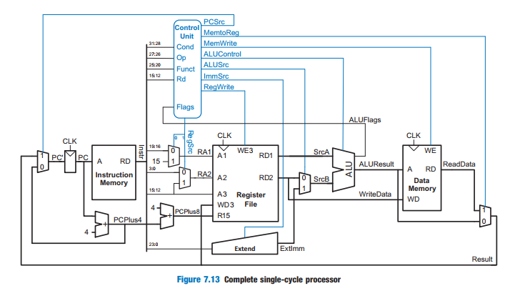
2. Introduction
We wanted to design a wall art that would be aesthetic and also could be helpful to visualize concepts learnt in the theory course of this lab.
We chose the Single Cycle Processor (ARM edition) for our demonstration.

Slide 5
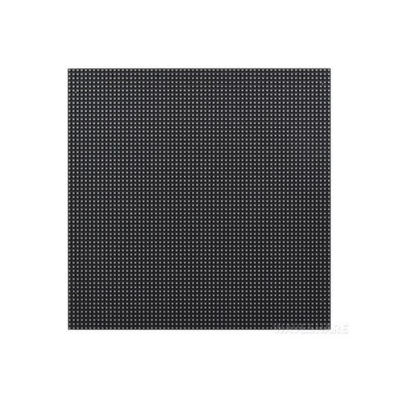
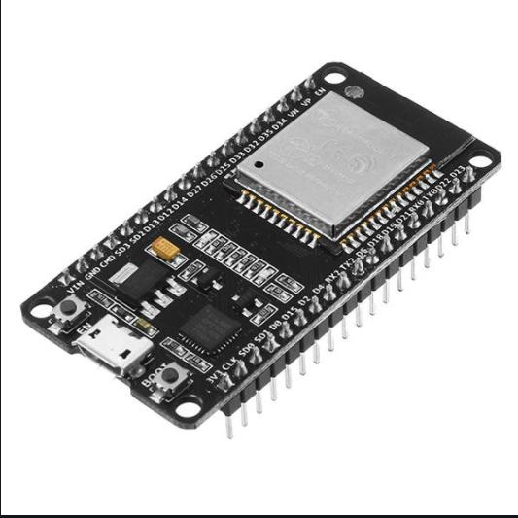
3.1 Design: Methods
This project was implemented using ESP32 and 3 64*64 LED Matrix Panels
We used the AdafruitGFX library from Waveshare Electronics for this task
Each datapath was made into an object of a class for greater control and automation
We used 2 boards for displaying the datapath demonstration and 1 board for instruction and control signal demonstration.

Slide 6
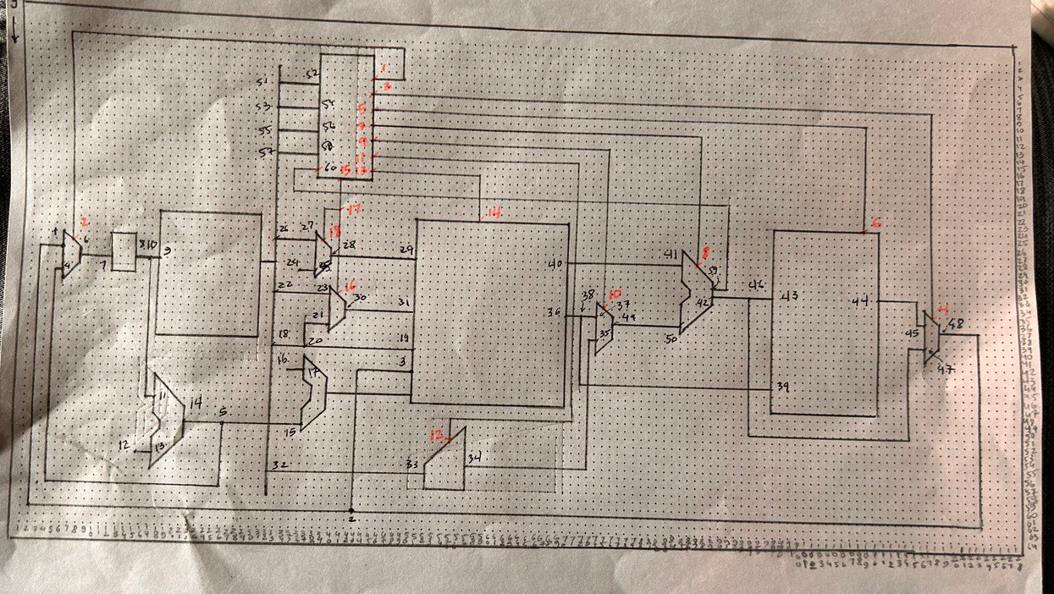
3.2 Design: Circuit Diagram
We mapped the whole datapath board into a 2D grid and drew the diagram
This made mapping the diagram into the board quicker

Slide 7
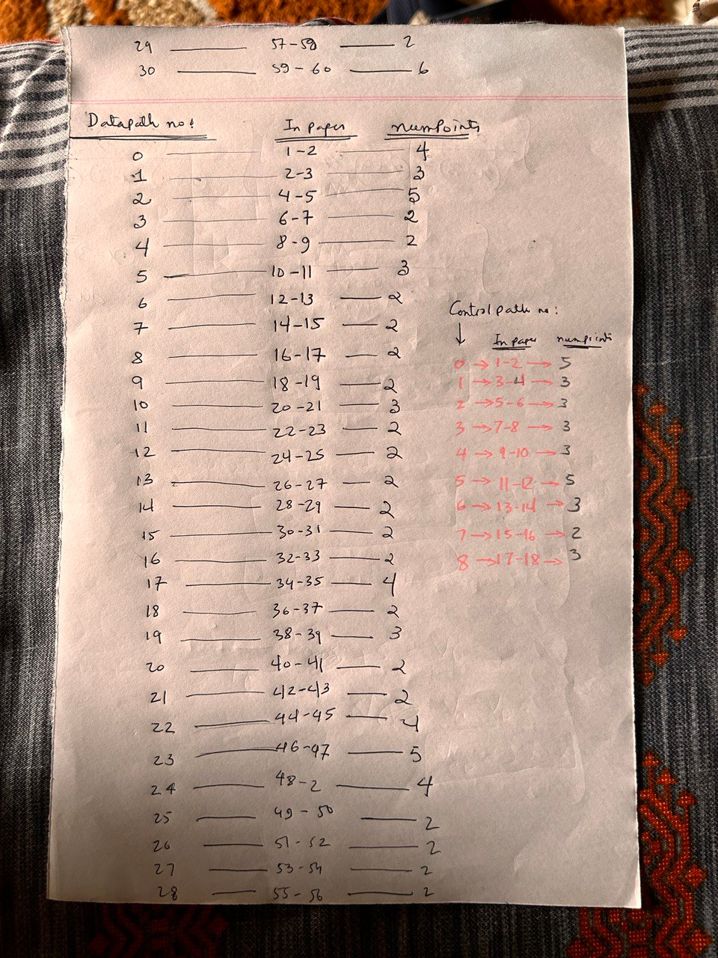
3.2 Design: Circuit Diagram
Each datapath and Control signal was given an unique ID for greater control

Slide 8
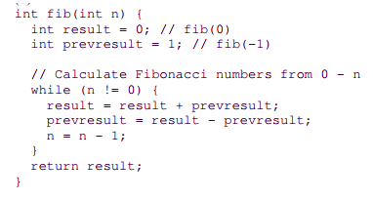
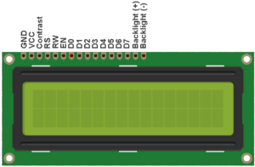

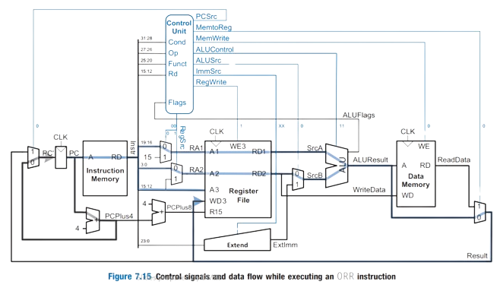
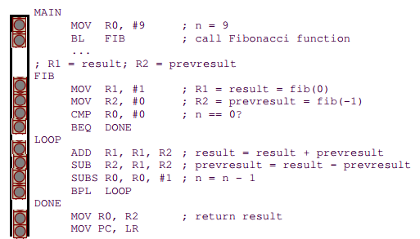
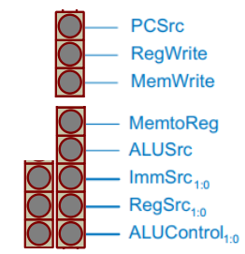
3.3 Design: Simulation
We did an ideation of the project, of how it would look like:
7 ADD R1, R1, R2
7 0xE0811002

Slide 9
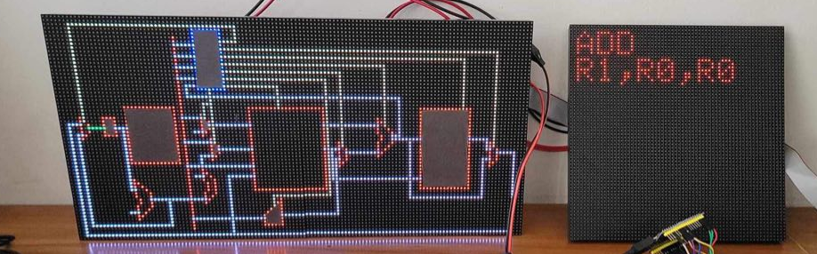
4 Implementation: Demonstration
The project turned out like this:
Note: This setup will be framed in the final presentation

Slide 10
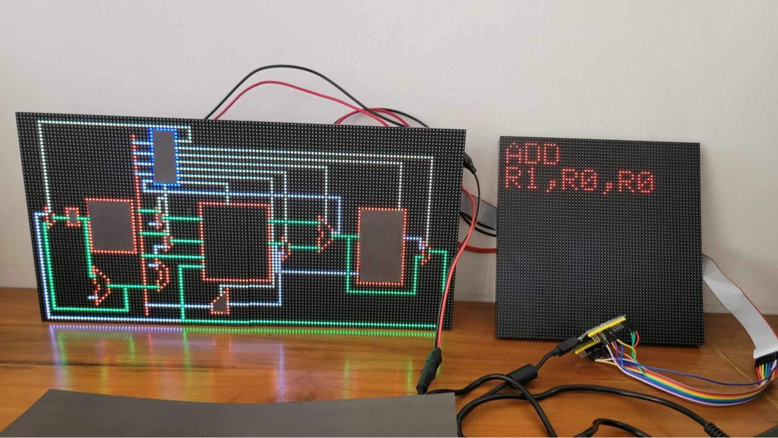
4.1 Implementation: Photo Gallary
Datapaths
Single Cycle Processor
Control Signals
Instruction
ESP32

Slide 11
5. Analysis and Evaluation
5.1 Novelty
5.2 Project Management and Cost Analysis
5.3 Practical Considerations of the Design
5.4 Assessment of the Impact of the Project
5.5 Evaluation of the Sustainability

Slide 12
5.1 Novelty
First demonstration of a SCP in a matrix panel
Visually captivating
Extendable to multiple instructions
Even can display datapath for the MOV command
Customizable and reprogrammable to modify the SCP

Slide 13
5.2 Project Management and Cost Analysis
Components | Price
RGB Panels (3) | 2120*3
ESP32 | 715
Power Adapter | 2230
Stationaries | 400
Frame | 500
Total | 10205

Slide 14
5.3 Practical Considerations of the Design
We initially thought of using an Arduino Mega as it had more pins, but we couldn’t as the speed of the Arduino Mega was not compatible with the refresh rate of the LED matrix
As we had to switch to ESP32, the pin number was reduced, and so we could not interface the LCD and the control LEDs
To remedy this, we used another LED Matrix to display the instructions, and decided to light up the control signals in the Main Board.

Slide 15
5.4 Assessment of the Impact of the Project
This project will help learners better grasp the datapaths in the Single Cycle Processor for the ARM architecture
Being visually captivating, it will enhance the ambiance of any learning environment
The source code for the project is written in a modular fashion, and can be modified and expanded for even bigger projects and dynamic codes

Slide 16
5.5 Evaluation of the Sustainability
This project is sustainable in any learning environment
As the whole board is mapped, new instruction blocks can be added
The LED Matrices are interfaced using HUB75, and so a lot of them can be chained together for future exploration

Slide 17
6.1 Individual Contribution of Each Member
Member ID | Contribution
1906013 | Hooking everything up
1906014 | Components selection and research
1906020 | Front end Design
1906029 | Back End Implementation

Slide 18
6.3 Logbook of Project
Week | Works done
Week-6 | Component Selection and Research
Week-7 | Component Buying
Week-8 | Hooking everything up in the Arduino Mega
Week-9 | Failing and debugging
Week-10 | Further component buy
Week-11 | Coding
Week-12 | Demonstrating

Slide 19
A 415 Art: Single Cycle Processor. References
https://github.com/topics/single-cycle-processor?o=asc&s=forks
https://www.waveshare.com/wiki/RGB-Matrix-P3-64x64
S.L. Harris, D.M. Harris, Digital Design and Computer Architecture (ARM Edition)

